Slide 1


Analytical Study of a Retail Accessories Shop
ADHYAN MISHRA
23f2000260@ds.study.iitm.ac.in
1

Slide 2
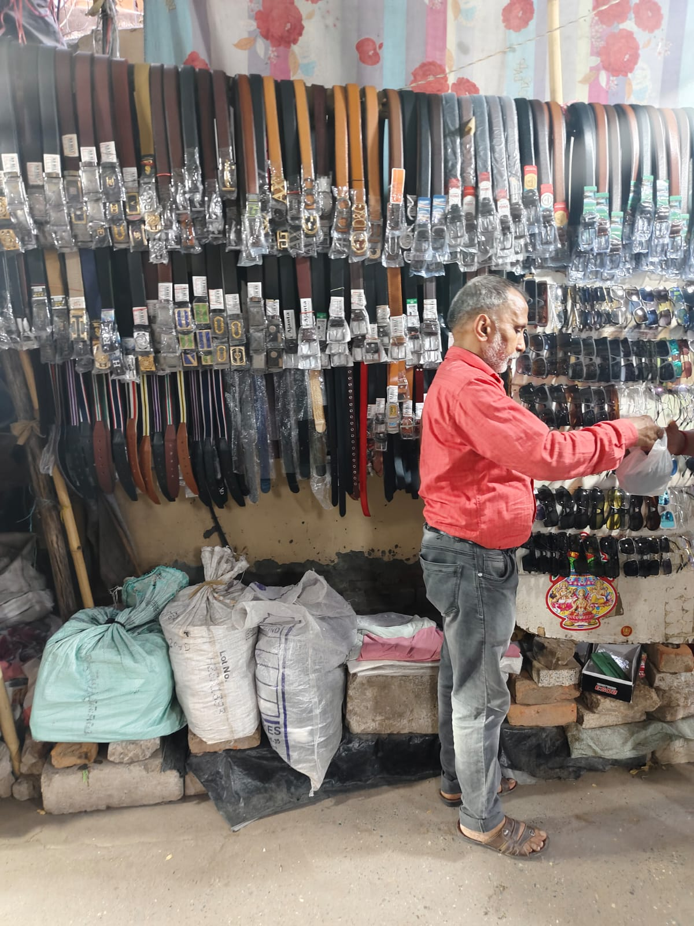
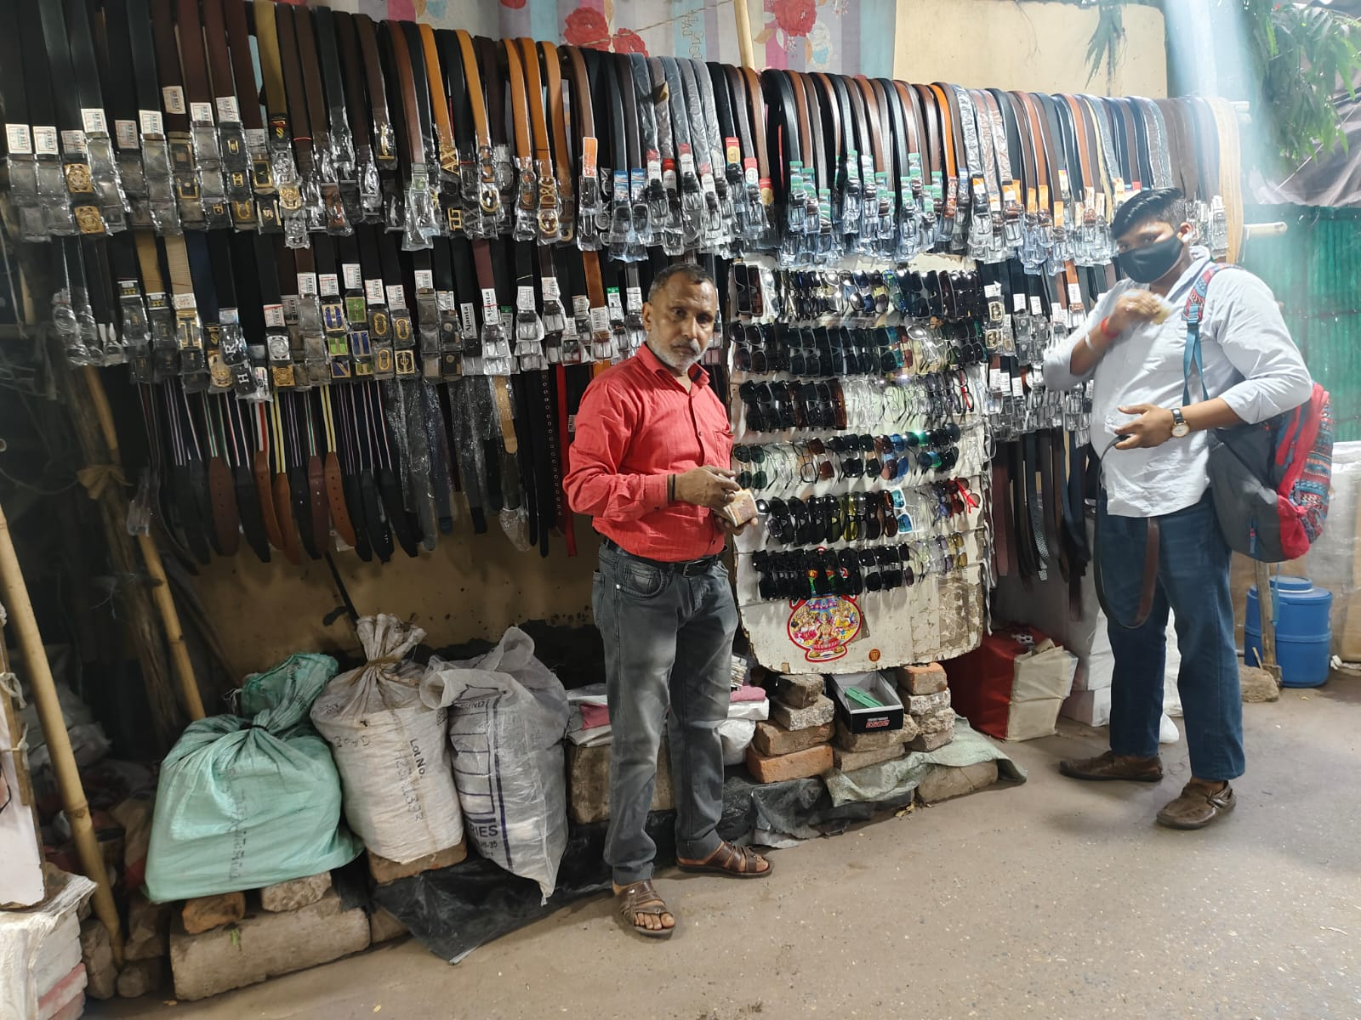
ABOUT THE BUSINESS
● Sudheer Kumar Belts & Goggles
is a well established
accessories selling business
with a 40-year legacy.
● Owned by Mr. Sudhir Kumar,
the business was originally a
family venture, now solely
managed by him.
● The business operates on B2C business model.
● Address : GT Road , Azadpur , North Delhi - 110033
2

Slide 3



CHALLENGES
The store is facing the problem of Dead Stock. In addition to tying up capital, excess inventory occupies valuable storage space and limits the ability to introduce new trends.
Shop experiences Stagnant Profit Generation, with sales and revenue remaining nearly constant across all months.
3

Slide 4
DATA OVERVIEW
To tackle these challenges following data was collected from the period
1 JULY, 2024 to 30 AUG, 2024.
01. Sales data
02. Inventory data
● Brands Name (Varieties)
● Cost Price
● Selling Price
● No of Items sold on a particular day.
● Data for Belts & Goggles is distinct.
● Quantity Bought
● Quantity left
● Date on which Items are bought.
● Data for Belts & Goggles is distinct.
4

Slide 5
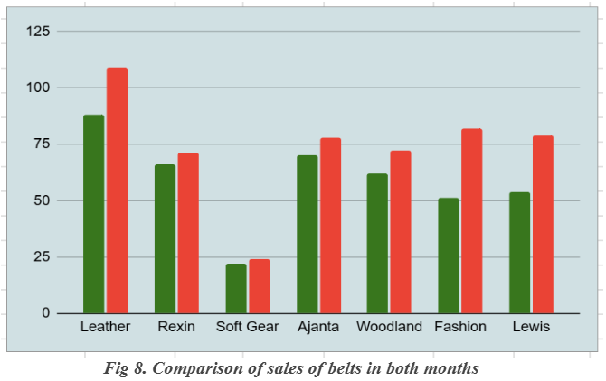
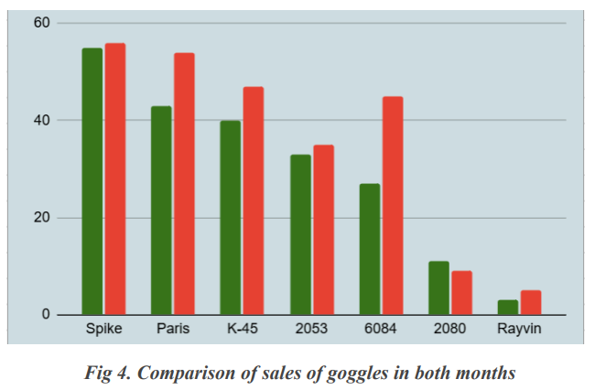
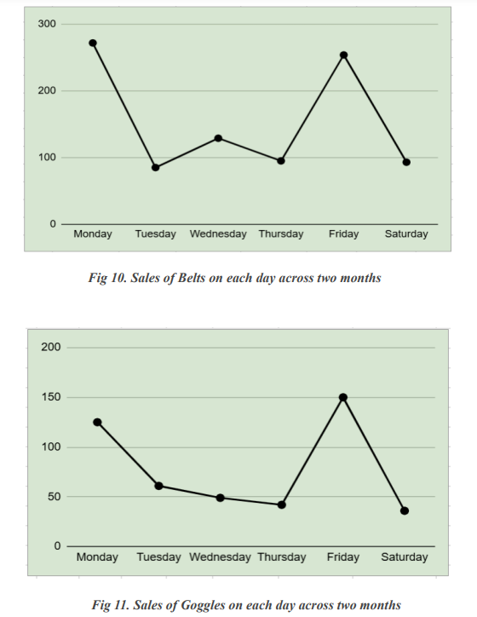
FINANCIAL OVERVIEW (SALES)
5

Slide 6
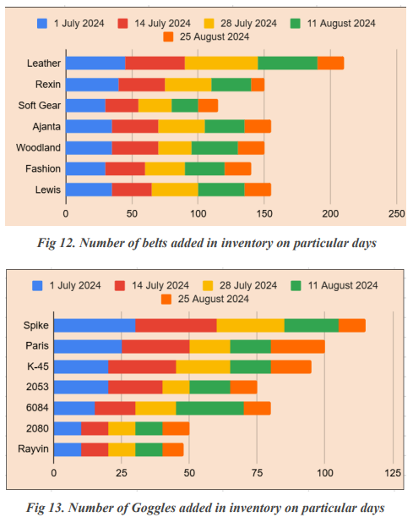
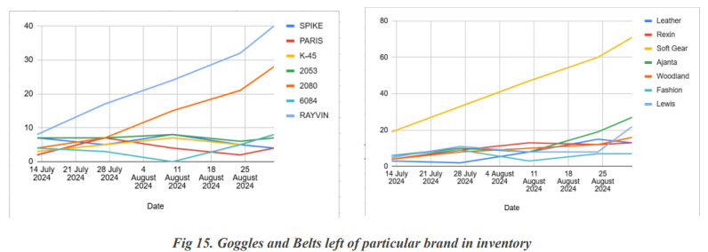
FINANCIAL OVERVIEW (INVENTORY)
6

Slide 7

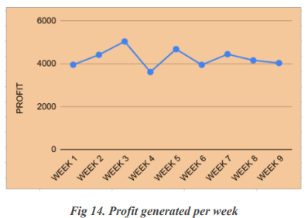
PROFITS
● Profits generated over the span of 9 weeks almost remain
same or fluctuates between 4,000 to 5,000 INR.
● The business shows regular profitability but lacks growth.
● One of the reasons of stagnant growth is competition with
other shops present in the market.
● And other reason that is determined from the analysis of all the data present is the dead stock items
present in the inventory , as they tie up the capital and reduces profitability.
7

Slide 8


Recommendations (to increase Profit)
● Focus on High-Margin Products
● Bundle Offers and Discounts
● Seasonal and Promotional Campaigns
● Enhance Store Layout and Display
● Leverage Customer Feedback
8

Slide 9
Recommendations (to reduce Dead Stock)
● Implement ABC Analysis Regularly
● Discount Dead Stock
● Adopt Data-Driven Purchasing Decisions
● Introduce Limited Stock for Low Demand Items
● Return or Exchange with Supplier
One of the best solutions is to focus more on MONDAY’s & FRIDAY’s as those are the market days. On these days giving 2+1 or 3+1 offers would be really great. Offering dead stock items for free with two good performing items would be really helpful to reduce dead stock and increase overall profitability.
9

Slide 10


BDM PROJECT -
● Sudheer Kumar Belts & Goggles
is a well established
accessories selling business
https://drive.google.com/drive/folders/1etBHtyKJqwYKZCw8tOjVTiYpYYPT65WF
THANK YOU
10

